Slide 1
Diabetes Prediction Chatbot
AI-Powered Early Risk Assessment and Personalized Preventive Measures

Slide 2

Introduction
Creating a chatbot in Python to build an AI-powered diabetes prediction system. Diabetes is a chronic disease that affects millions of people worldwide. Early risk assessment and personalized preventive measures are crucial for managing diabetes and preventing its complications. With our chatbot, we can help individuals monitor their health more effectively and take proactive actions to manage their condition.
By leveraging machine learning algorithms and natural language processing, we can create intelligent chatbots that can provide personalized medical advice, answer questions, and even detect potential health problems.

Slide 3

Understanding Diabetes
Diabetes is a chronic condition that affects the way your body processes blood sugar. Some of the risk factors associated with diabetes include genetics, obesity, and a sedentary lifestyle. People with diabetes need to monitor their blood sugar levels regularly and make lifestyle changes to manage their condition.

Slide 4

The Role of Machine Learning in Diabetes Prediction
Machine learning algorithms play a crucial role in predicting the likelihood of an individual developing diabetes. By analyzing medical data such as blood sugar levels, body mass index, and family history, these algorithms are able to identify patterns and make accurate predictions.
Logistic regression analyzes the relationship between multiple variables and calculates the probability of an individual developing diabetes based on their specific risk factors. Other algorithms, such as decision trees and neural networks, can also be used for this purpose.

Slide 5
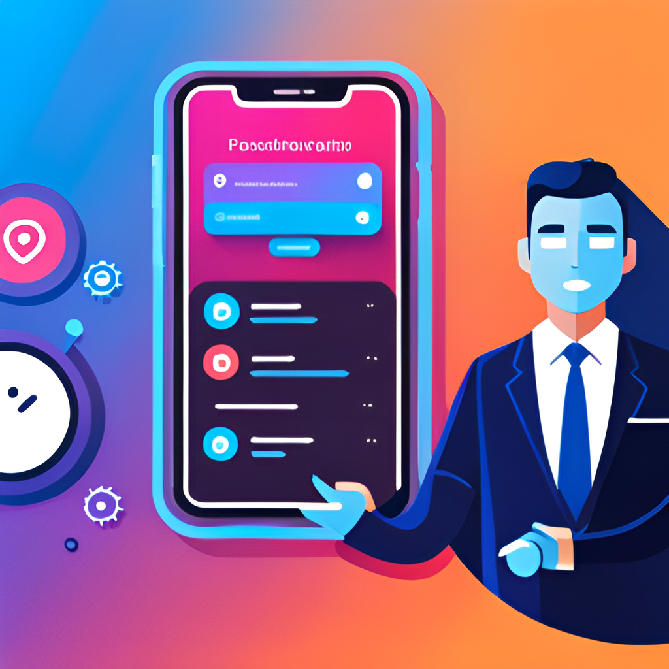
Integrating Machine Learning Algorithms into the Chatbot
To integrate machine learning algorithms into the chatbot, we first need to train our model on a dataset of medical records. This involves selecting relevant features and labels, such as blood glucose levels, age, and family history of diabetes.
Once our model is trained, we can integrate it into the chatbot using Python's natural language processing libraries. When a user interacts with the chatbot, it can ask questions about their medical history and lifestyle habits, and use this information to make personalized predictions about their risk of developing diabetes.

Slide 6

Conclusion
By using machine learning algorithms to analyze medical data, we can predict the likelihood of an individual developing diabetes and take proactive actions to manage their health. The process of building a chatbot in Python and integrating machine learning algorithms will be useful to improve healthcare and make a positive impact on people's lives.

